Slide 1

Debugging python code; Conditional executions
Python Programming | Values and Debugging python code
Course: Python Programming | Chapter: Values and Debugging python code | Bachelor of Computer Science and Engineering
DISCOVER · LEARN · EMPOWER
Notes:
Welcome to today's lecture on debugging and conditional executions. We will focus on how to identify logical errors in Python code and understand the flow of conditional statements. This session is designed to help you write robust code that handles various scenarios correctly.

Slide 2
Course Outcomes
SLIDE 2 / 14
Course Outcome
CO | BT LEVEL | DESCRIPTION
CO1 | BT1 | Understand the syntax, control structures, and basic constructs of Python programming language
CO2 | BT3 | Apply functions, modules, and exception handling for modular program development
CO3 | BT3 | Implement data structures including lists, tuples, dictionaries, and sets for efficient data processing
CO4 | BT4 | Analyze and manipulate files, strings, and perform data handling operations
CO5 | BT5 | Design and develop real-world applications integrating multiple Python concepts
Chandigarh University
2 / 14
Notes:
Today's lecture directly supports Course Outcome 3. By mastering debugging and conditional logic, you learn to implement data structures like lists and dictionaries efficiently. You will see how conditional checks prevent errors when processing these complex data types.

Slide 3
Learning Objectives
SLIDE 3 / 14
Learning Outcomes
1
Analyze common logical errors in conditional execution blocks
2
Evaluate the impact of indentation on Python code flow
3
Construct robust debugging strategies for nested conditionals
4
Differentiate between syntax errors and logical runtime errors
5
Apply systematic testing to verify conditional logic correctness
Chandigarh University
3 / 14
Notes:
By the end of this session, you will be able to analyze logical errors and evaluate how indentation affects code flow. We will construct robust debugging strategies and differentiate between syntax and logical errors. You will apply systematic testing to verify your conditional logic.

Slide 4
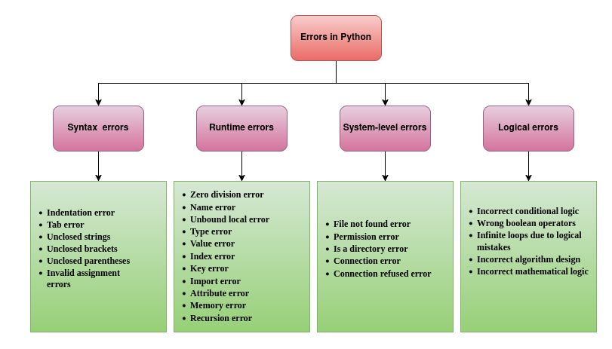
Lecture
SLIDE 4 / 14
Understanding Logical Errors
EXAMPLE
Using 'or' instead of 'and' in a validation check
• Logical errors occur when code runs but produces incorrect results
• The interpreter does not flag logical errors as syntax errors
• Debugging requires tracing the execution path manually or with tools
• Common causes include wrong operators or incorrect condition logic
• A logical error in a loop can cause infinite execution cycles
• The program executes without crashing but fails the business logic
Errors in Python: Types, Causes, and Examples - Honeybadger Developer Blog
Chandigarh University
4 / 14
Notes:
Logical errors are the most frustrating because the code runs without crashing. For instance, if you use 'or' instead of 'and' in a login check, the program accepts any password. You must trace the execution path to find where the logic diverges from the intended behavior.

Slide 5
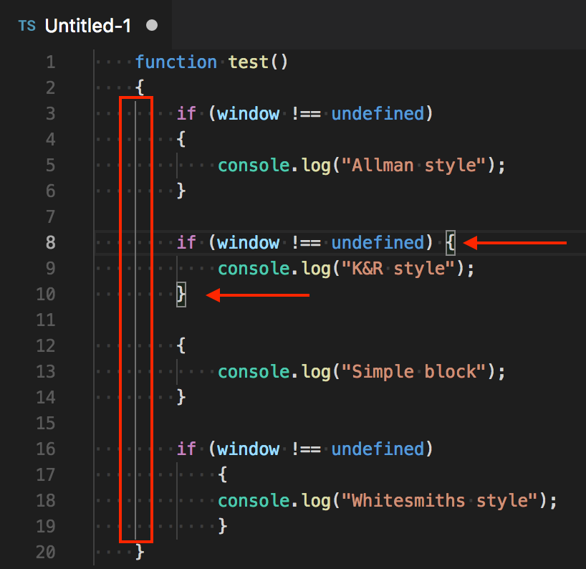
Lecture
SLIDE 5 / 14
Indentation and Code Blocks
1
Python uses indentation to define code blocks instead of braces
2
Incorrect indentation changes the scope of conditional statements
3
A single space error can move a statement outside an if block
4
The interpreter raises an IndentationError if indentation is inconsistent
5
Consistent 4-space indentation is the standard convention in Python
6
Misaligned blocks cause variables to be undefined in later steps
7
Debugging often starts by checking the visual alignment of code
Source: user-images.githubusercontent.com
Chandigarh University
5 / 14
Notes:
Indentation is critical in Python as it defines the scope of your code. If you misalign a line, the interpreter might treat a statement as outside the conditional block. This often leads to undefined variable errors or logic that runs when it shouldn't.

Slide 6
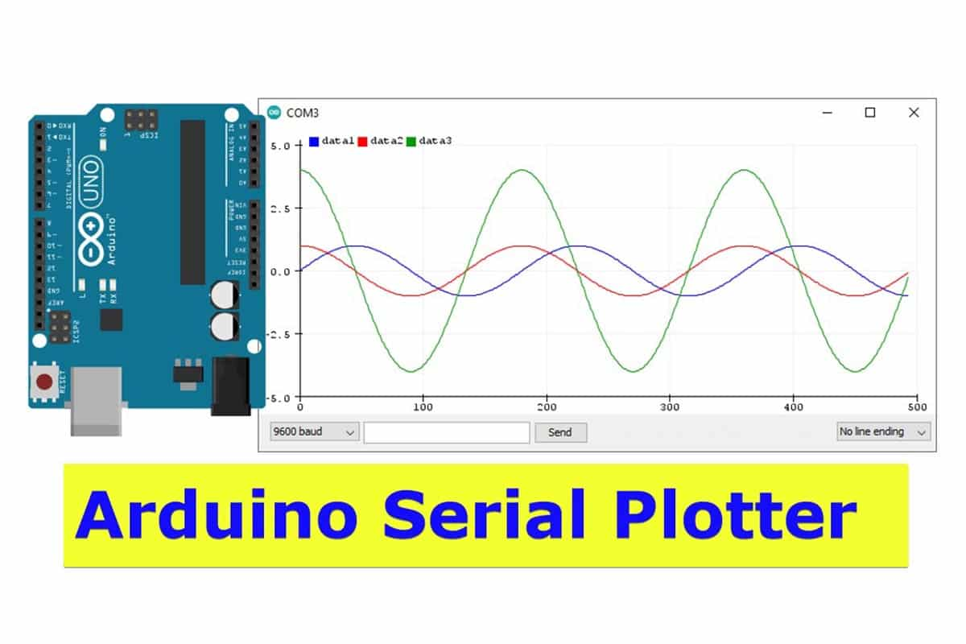
Lecture
SLIDE 6 / 14
Debugging with Print Statements
1
Print statements are the simplest method to trace variable values
2
Insert prints before and after conditional blocks to verify flow
3
Print the boolean result of conditions to check logic evaluation
4
Use print to display the state of data structures during loops
5
This method helps identify where the program deviates from expectations
6
Overusing prints can clutter the console and slow execution
7
Remove debug prints once the logical error is identified and fixed
Source: www.makerguides.com
Chandigarh University
6 / 14
Notes:
Print statements are your first line of defense for debugging. By printing the boolean result of a condition, you can see exactly how Python evaluates it. For example, printing 'x > 5' helps you see if the variable holds the expected value.

Slide 7
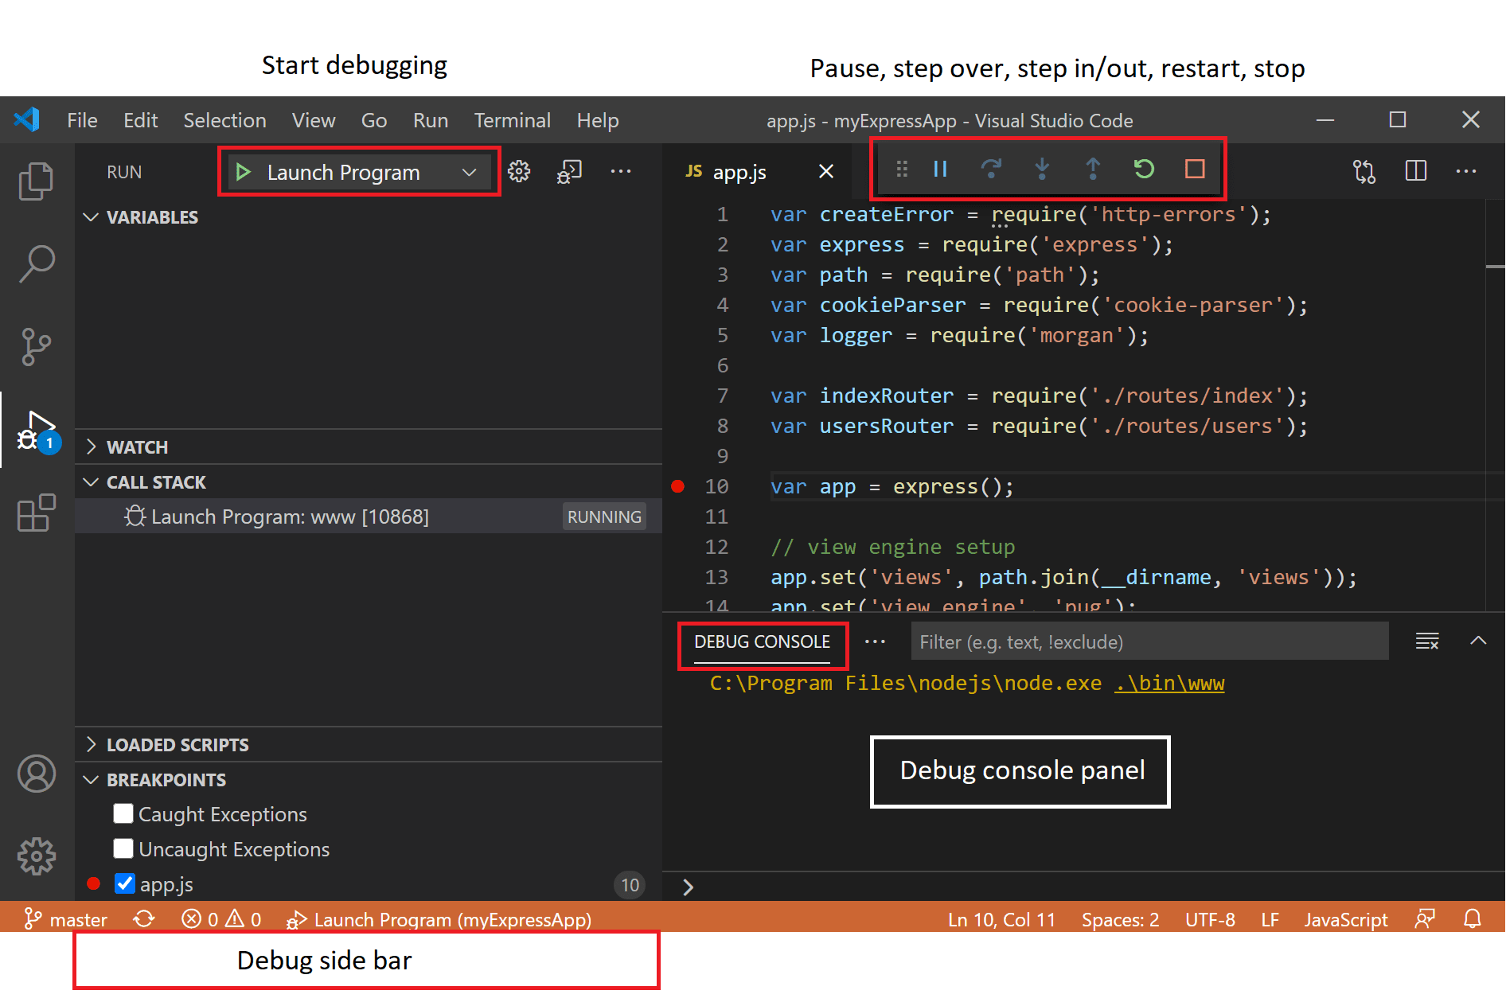
Lecture
SLIDE 7 / 14
Using Breakpoints and Debuggers
1
IDEs like PyCharm and VS Code offer built-in debugging tools
2
Breakpoints pause execution at specific lines for inspection
3
Step-over and step-into commands allow line-by-line tracing
4
Inspect variables in real-time to see their current state
5
Watch expressions let you monitor complex data structures dynamically
6
Debuggers are superior for finding errors in large codebases
7
They provide a visual representation of the call stack and memory
Source: code.visualstudio.com
Chandigarh University
7 / 14
Notes:
Modern IDEs provide powerful debugging tools that go beyond print statements. You can set breakpoints to pause execution and inspect variables in real-time. This allows you to see exactly how your data structures change as the program runs.

Slide 8
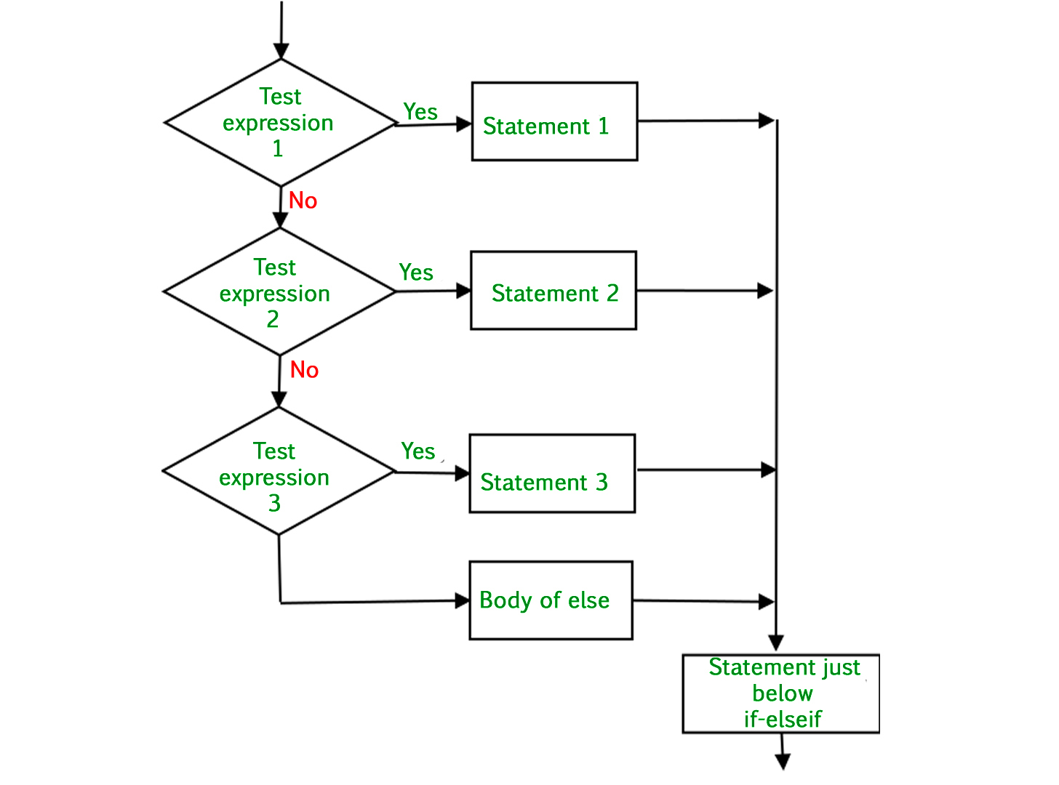
Conditional Execution
SLIDE 8 / 14
If-Elif-Else
1
The if statement executes a block only if the condition is true
2
The elif clause checks additional conditions if the first is false
3
The else block executes if all preceding conditions are false
4
Only one block in the chain executes per conditional evaluation
5
Conditions are evaluated sequentially from top to bottom
6
The first true condition triggers its block and skips the rest
7
Proper ordering of conditions ensures the most specific logic runs first
Source: media.geeksforgeeks.org
Chandigarh University
8 / 14
Notes:
The if-elif-else structure allows you to handle multiple scenarios in a single block. Python evaluates conditions sequentially, executing the first true block and skipping the rest. It is crucial to order your conditions from most specific to most general to avoid logic errors.

Slide 9
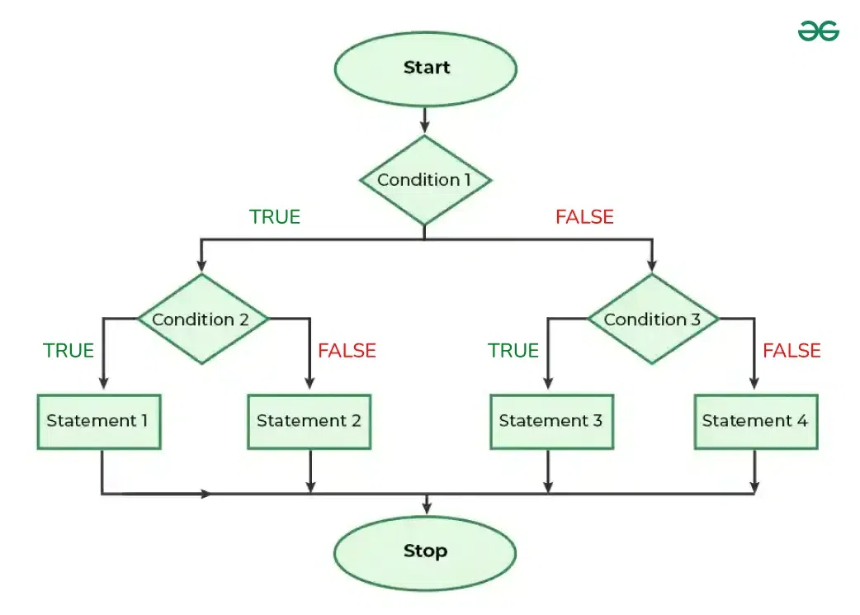
Lecture
SLIDE 9 / 14
Nested Conditionals and Logic
1
Nested conditionals place an if statement inside another if block
2
They allow for complex decision-making based on multiple criteria
3
Deep nesting can reduce code readability and increase error risk
4
Logical operators (and, or, not) can simplify nested structures
5
Use early returns to flatten deeply nested conditional logic
6
Debugging nested logic requires tracing every possible execution path
7
A single false condition in a nested block can alter the outcome
Source: media.geeksforgeeks.org
Chandigarh University
9 / 14
Notes:
Nested conditionals are powerful but can become hard to read quickly. For example, checking if a user is an admin and then if they have access to a specific file requires nested logic. You can often simplify this using logical operators like 'and' to combine conditions.

Slide 10
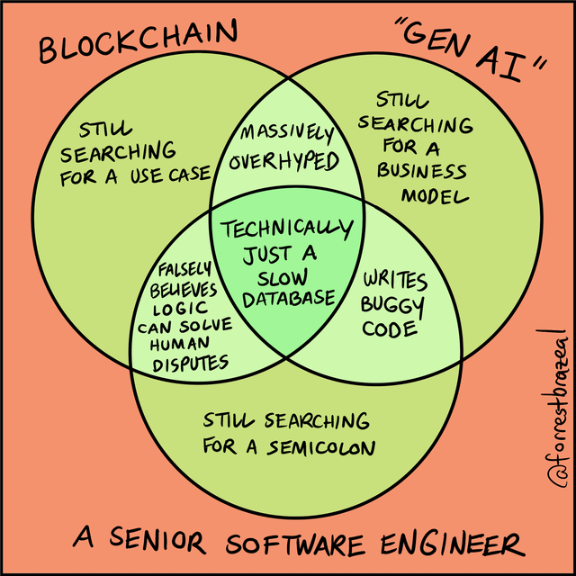
Worked Example
SLIDE 10 / 14
Grade Calculator
GOVERNING EQUATION
Logic: Score >= 90 is A, >= 80 is B, >= 70 is C
SCENARIO
Assign grades based on score using if-elif-else logic
CODE
if score >= 90: grade = 'A' elif score >= 80: grade = 'B'
ERROR
Using 'or' in condition 'score >= 90 or score >= 80'
RESULT
Any score >= 80 incorrectly gets an 'A' grade
FIX
Remove 'or' to ensure strict range checking for each grade
DEBUGGING
Print the score and condition result to verify logic
Source: preview.redd.it
Chandigarh University
10 / 14
Notes:
Consider a grade calculator where a student scores 85. If you write 'score >= 90 or score >= 80', the condition is true for 85, incorrectly assigning an 'A'. The correct logic checks ranges sequentially. Debugging this involves printing the score and the boolean result of each condition.

Slide 11
Lecture
SLIDE 11 / 14
Common Pitfalls in Conditionals
GOVERNING EQUATION
Using assignment '=' instead of comparison '==' in conditions
1
Floating point comparison errors due to precision limitations
2
Ordering conditions incorrectly leading to unreachable code blocks
3
Forgetting to handle the else case for unexpected inputs
4
Using mutable default arguments in functions with conditional logic
5
Assuming boolean conversion of non-zero numbers always works
6
Neglecting to test edge cases like zero or negative values
Chandigarh University
11 / 14
Notes:
A common pitfall is using a single equals sign for comparison, which assigns a value instead of checking it. Another issue is floating-point precision, where 0.1 + 0.2 might not equal 0.3 exactly. Always test edge cases like zero or negative values to ensure your logic holds.

Slide 12
Lecture
SLIDE 12 / 14
Debugging Data Structures in Loops
1
Conditional logic often drives iteration over lists and dictionaries
2
Errors occur when accessing keys that do not exist in a dict
3
Index errors happen when loop bounds exceed list length
4
Use 'in' operator to check for key existence before access
5
Debugging requires checking the state of the data structure at each step
6
Print the current index and value to trace loop execution
7
Ensure conditional checks prevent out-of-bounds access in lists
Chandigarh University
12 / 14
Notes:
When iterating over data structures, conditional logic must prevent errors like accessing non-existent keys. For example, trying to access a key in a dictionary that doesn't exist will crash the program. Always use the 'in' operator to check for key existence before accessing it.

Slide 13
Lecture
SLIDE 13 / 14
Key Takeaways
1
Logical errors produce wrong results without crashing the program
2
Indentation defines code blocks and scope in Python strictly
3
Use print statements and debuggers to trace execution paths
4
Order conditions carefully to ensure correct logic flow
5
Test edge cases and handle exceptions for robust data processing
Chandigarh University
13 / 14
Notes:
To summarize, logical errors are subtle but critical to identify. Indentation is the backbone of Python's structure, so always be consistent. Use debugging tools to trace your code and test edge cases to ensure your conditional logic is robust.

Slide 14
Lecture
SLIDE 14 / 14
References
PYTHON
A Practical Learning Approach, 1st Edition — T.S. Murugesh, Shriram K. Vasudevan, Sini Raj Pulari
• Learning Python, 6th Edition — Mark Lutz
• Starting Out with Python, Global Edition, 6th Edition — Tony Gaddis
• Introduction to Python Programming and Data Structures, 3rd Edition — Y. Daniel Liang
Chandigarh University
14 / 14
Notes:
These reference books provide comprehensive coverage of Python programming and data structures. They are excellent resources for deepening your understanding of debugging techniques and conditional logic. Please refer to them for further study and practice problems.

